Slide 1
unsupervised domain adaptation for image classification Using the second order statistic
Joel Bjervig Mikael Westlund Arash Owrang Alireza Razavi
Notes:
JOEL

Slide 2
Introduction
Resource intensive to annotate LiDAR images
Unsupervised learning: Utilize intrinsic structure of data
Transfer learning: Utilize already labeled data and/or pretrained models from one “domain” and make them perform in another domain
Domain adaptation: source and target domain have:
same labels
same feature space (32x32 grayscale images, pixel 0-255)
differently distributed data
Notes:
JOEL

Slide 3
Project Aim
Investigate possibility to:
Decrease the discrepancy between the features of the two datasets: camera and LiDAR
Minimize domain shift
Increase classifier performance on LiDAR images with no LiDAR labels
Supervised learning on camera data
infuse statistical information from the LiDAR features
Notes:
JOEL

Slide 4
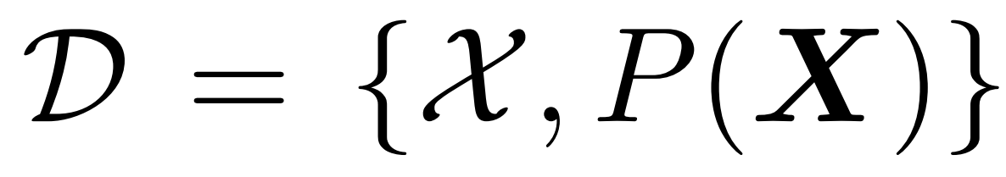
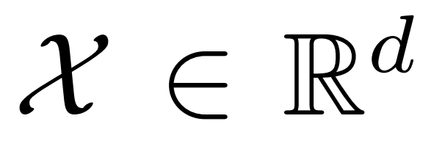
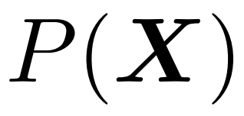
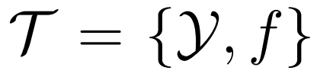
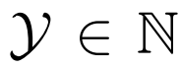
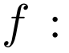
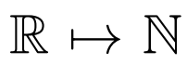
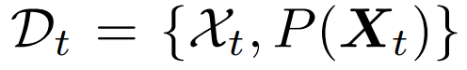
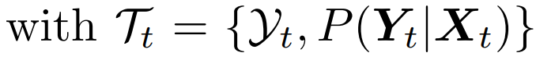
DOMAINS and tasks
Domain
feature space
marginal probability function
Task
label space
decision function
Source
Target - But no labels!
Notes:
JOEL

Slide 5
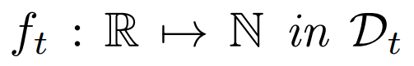
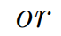
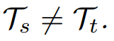
Transfer Learning
Given a source domain
and a target domain
Improve learning on target predictive function
,
Using knowledge from
Notes:
JOEL

Slide 6
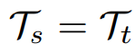
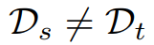
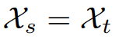
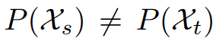
Domain adaptation
..is transductive transfer learning, meaning:
Same task
Domain-shift
Same feature space
Different marginal distributions

Slide 7
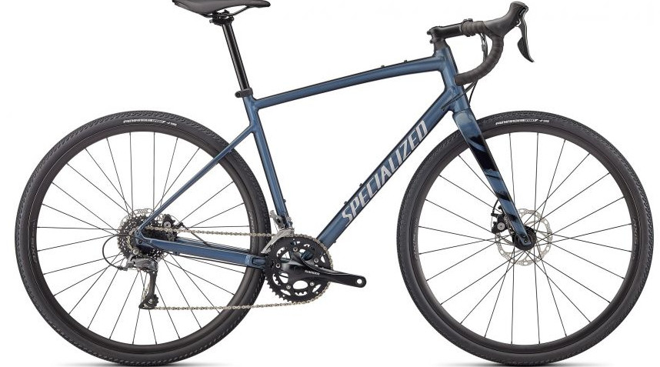
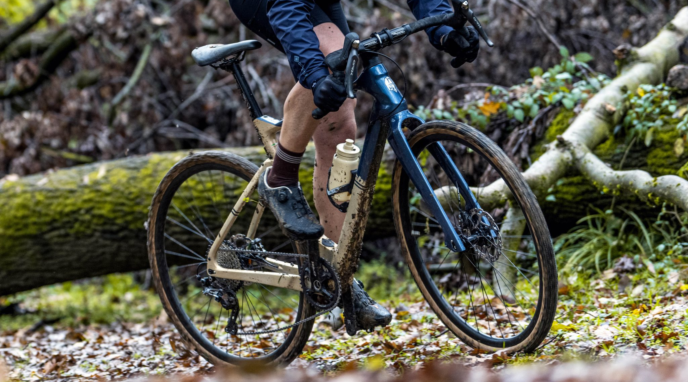

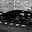
Examples of domain shift
Image Classification
Context: product photo to user photo
Camera to LiDAR
Notes:
JOEL

Slide 8
Shallow CORAL
CORAL – Covariance Alignment
1. Align the covariance of the camera features to the LiDAR features.
2. Train on the aligned camera features.
Unsupervised method
(no labels for the lidar data needed during training)
Notes:
JOEL

Slide 9
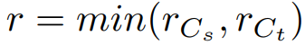
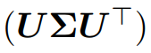
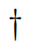
shallow CORAL
Mathematical formulation:
F: Frobenius norm or Euclidean norm
solution:
For ill posed covariance matrices
lowest rank
Singular value decomposition
Moore-Penrose pseudo inverse
For full-rank covariance matrices
Notes:
JOEL

Slide 10
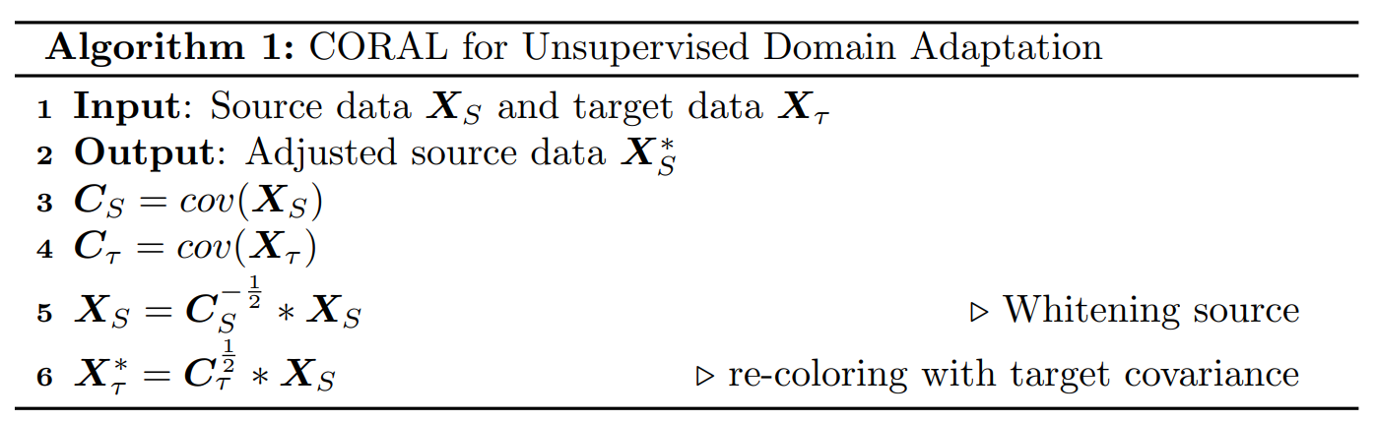
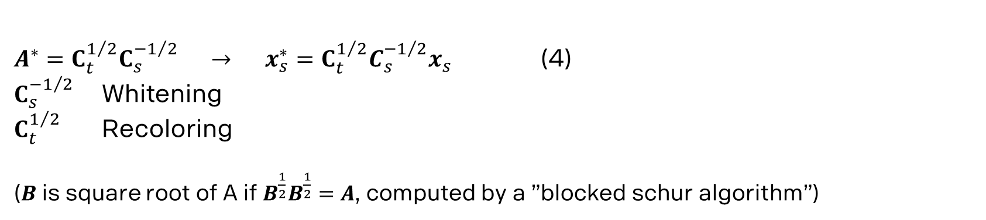
CORAL - Algorithm
$A^{∗}=C_{t}^{1/2}C_{s}^{−1/2} → x_{s}^{∗}=C_{t}^{1/2}{C_{s}^{−1/2}x}_{s}$ (4)
$C_{s}^{−1/2}$ Whitening
$C_{t}^{1/2}$ Recoloring
($B$ is square root of A if $B^{\frac{1}{2}}B^{\frac{1}{2}}=A$, computed by a ”blocked schur algorithm”)
Notes:
JOEL

Slide 11
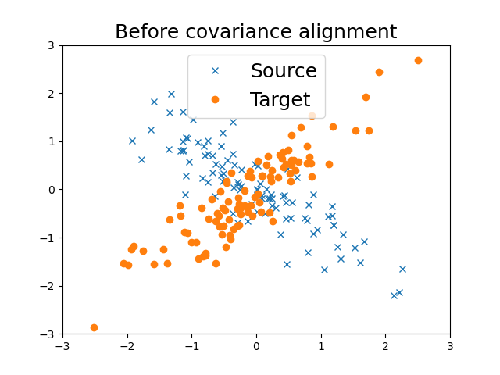
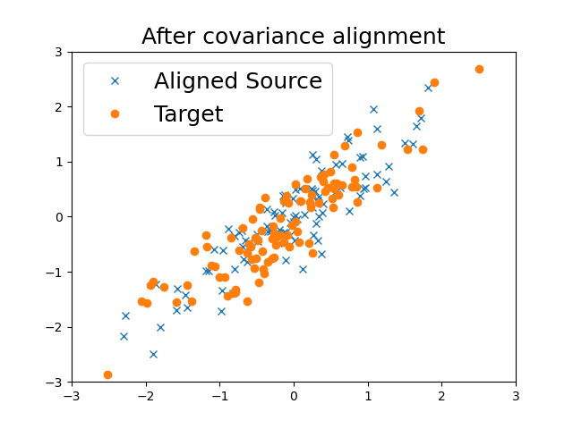
CORAL – 2D EXAMPLE
Notes:
JOEL

Slide 12
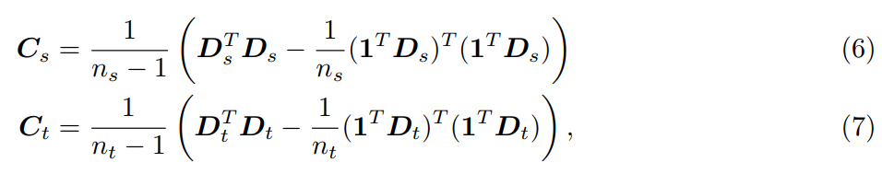
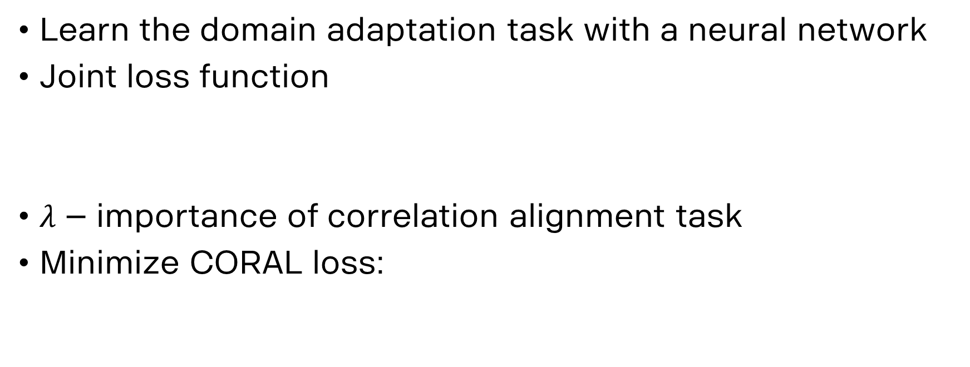
Deep CORAL
Learn the domain adaptation task with a neural network
Joint loss function
$λ$ – importance of correlation alignment task
Minimize CORAL loss:
( )

Slide 13
Data acquisition and preprocessing
Originally 4 classes: Car, Large car, Human and Other.
Labeling problems due to Ouster and Scania.
pickup truck ∈ Car (camera) pickup truck ∈ Large Car (LiDAR)
Solution: Reduce to the 2 classes
“cars” and “pedestrians”
Notes:
MIKAEL

Slide 14
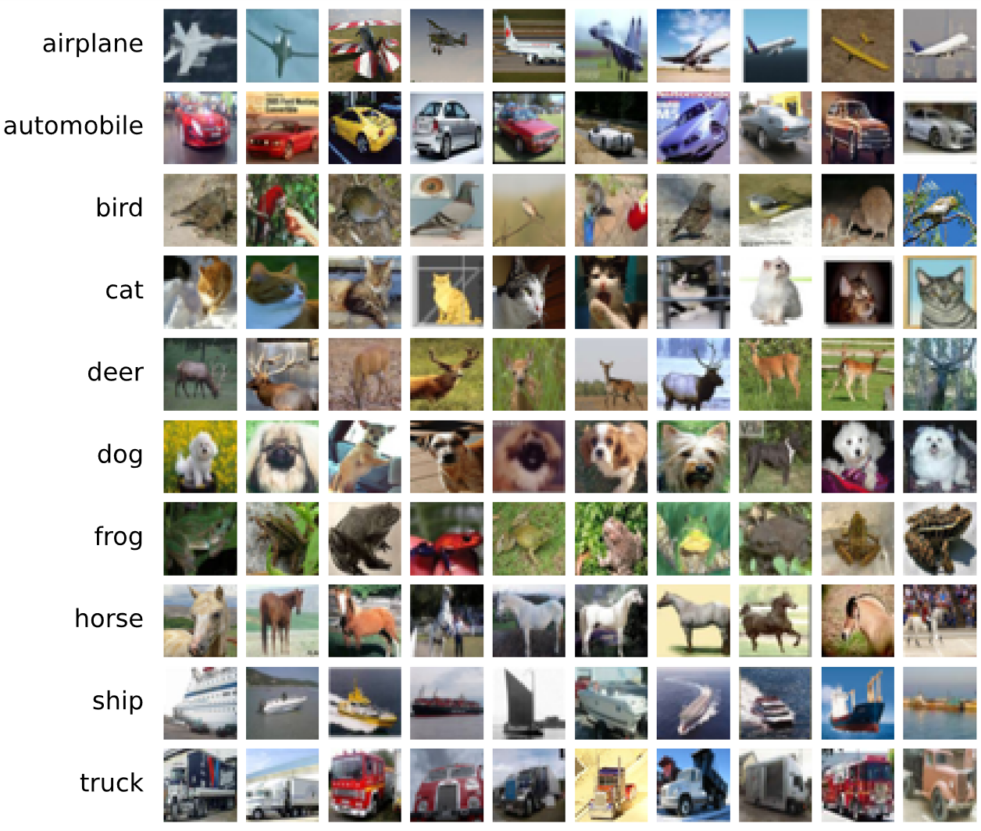
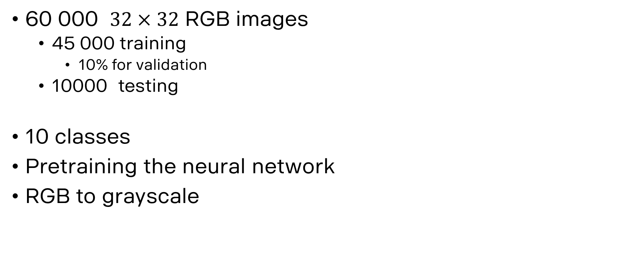
cifar-10
60 000 $32×32$ RGB images
45 000 training
10% for validation
10000 testing
10 classes
Pretraining the neural network
RGB to grayscale

Slide 15
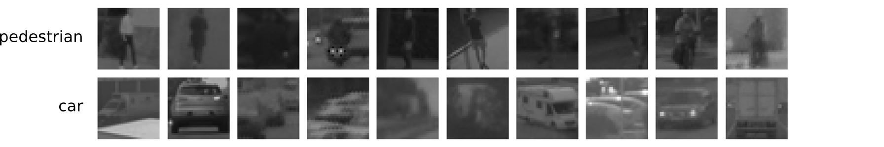
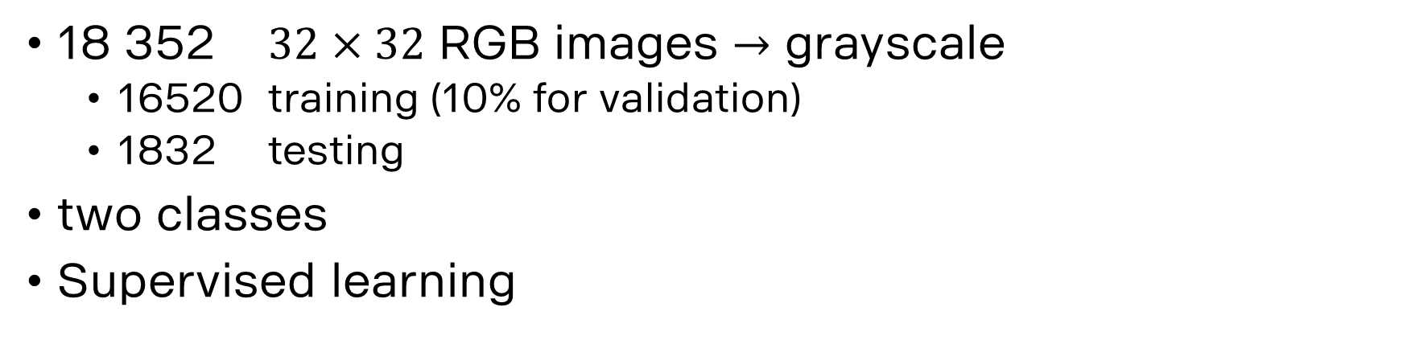
SCANIA camera images
18 352 $32×32$ RGB images $→$ grayscale
16520 training (10% for validation)
1832 testing
two classes
Supervised learning

Slide 16
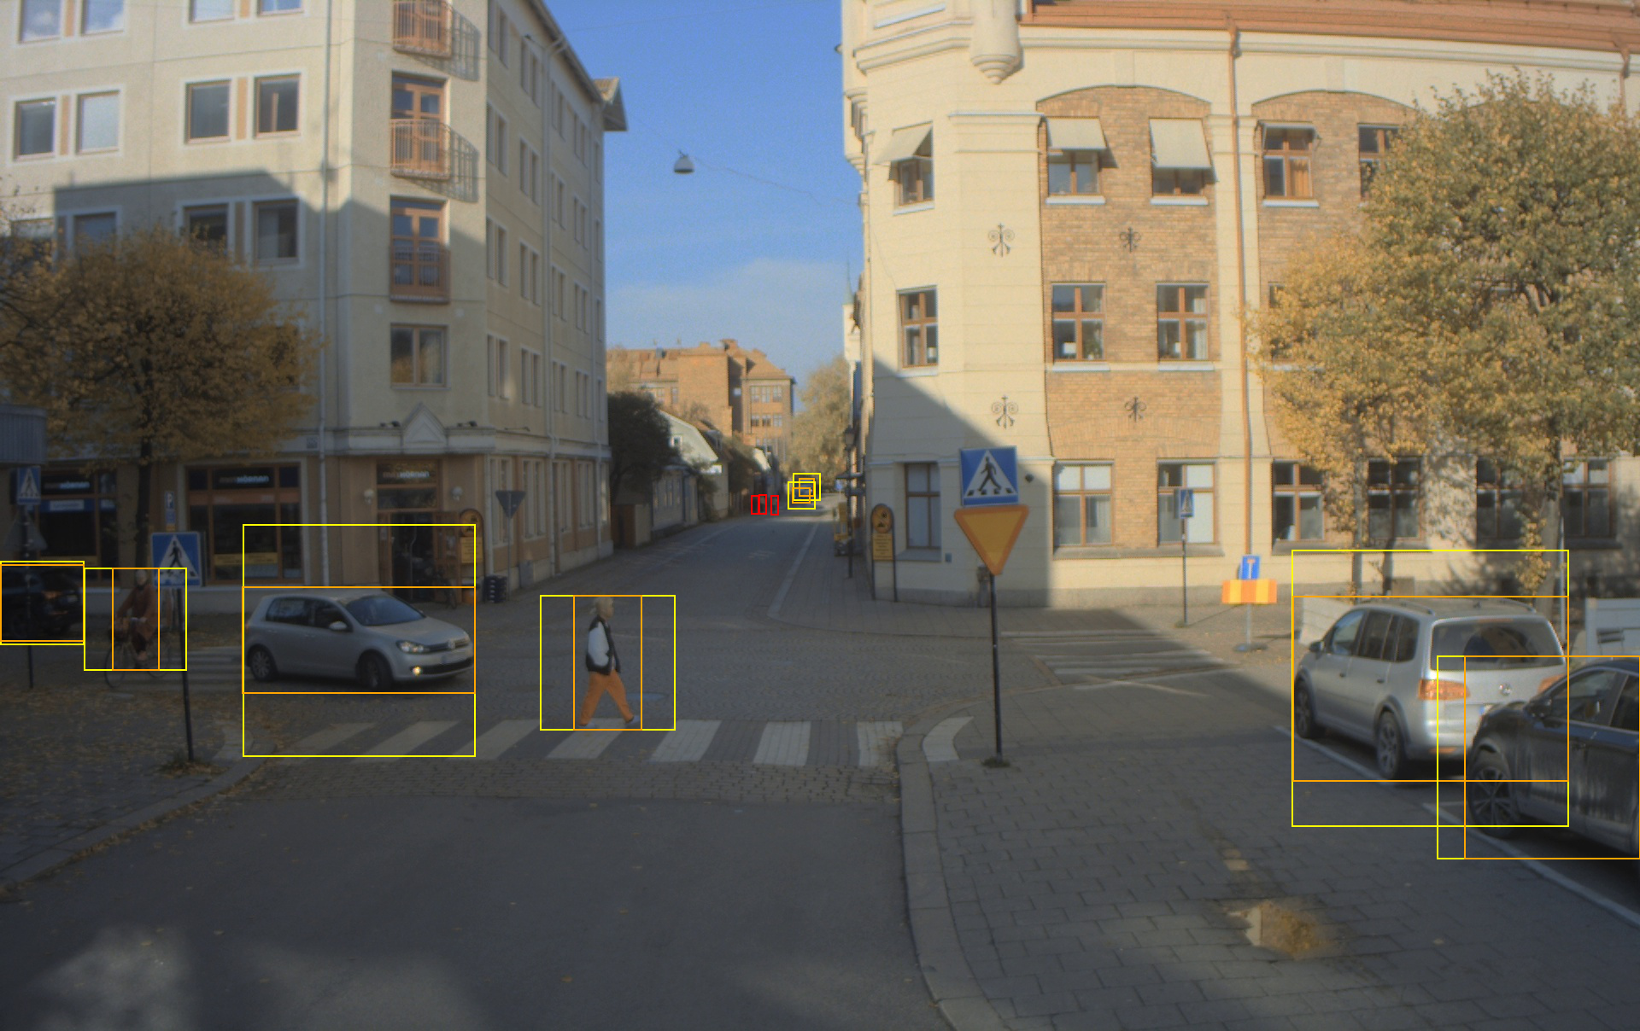
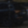





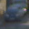
camera images - cropping

Slide 17
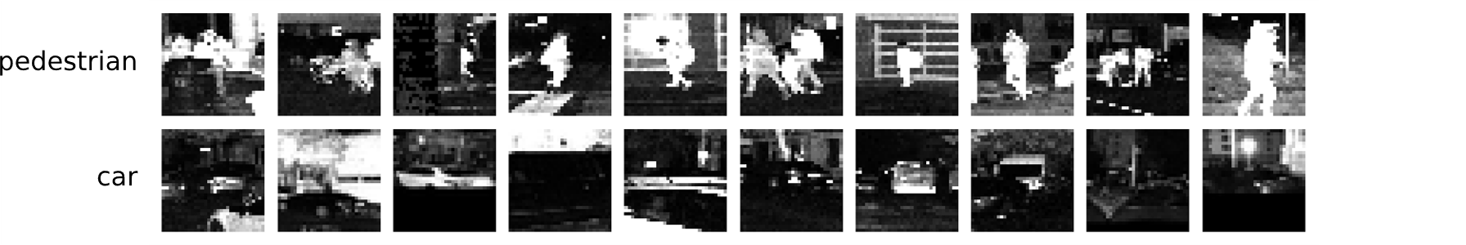
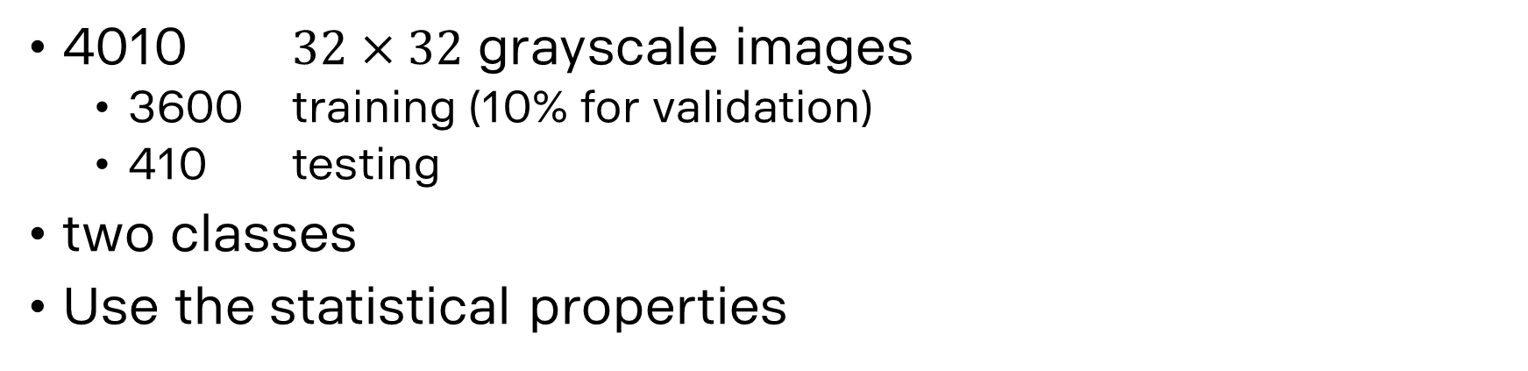
lidar intensity images
4010 $32×32$ grayscale images
3600 training (10% for validation)
410 testing
two classes
Use the statistical properties

Slide 18
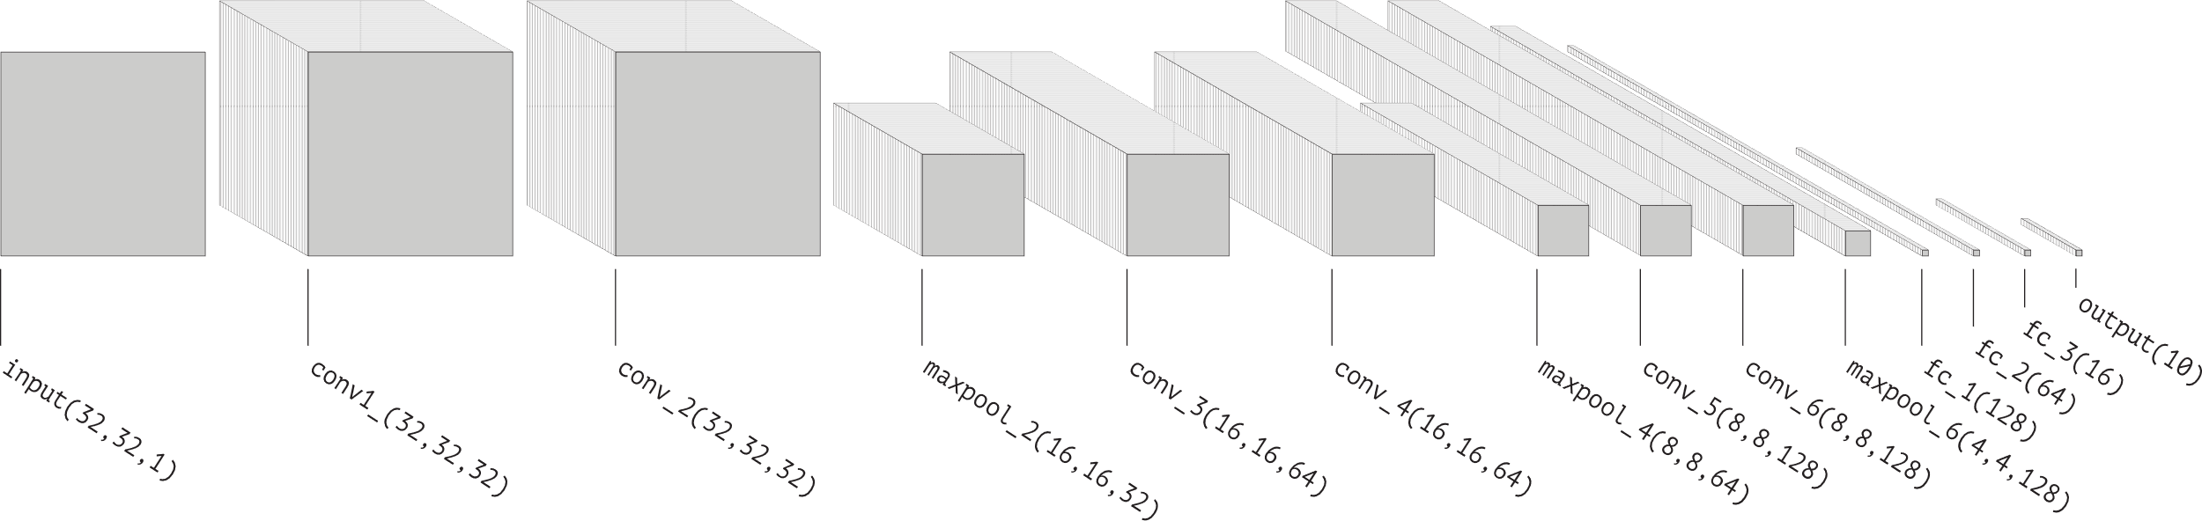
Pretraining CNN model
Pretrain convolutional neural network (CNN) on Cifar-10
Network architecture inspired by VGG structure
Three blocks of two convolutional and one maxpool layer
Four fully connected layers
Notes:
JOEL

Slide 19
Pretraining CNN model
SGD momentum optimizer
Cross entropy loss function
Weight initialization for the other models
Notes:
JOEL

Slide 20
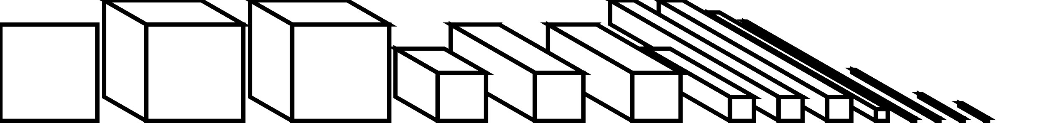
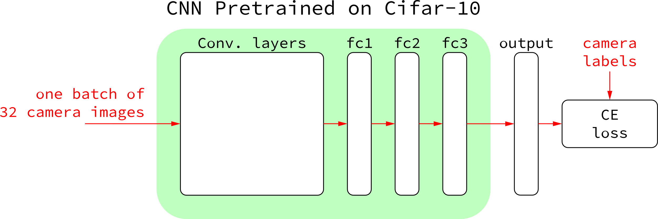
finetuned model
Supervised learning to classify camera data
No domain adaptation task
Notes:
JOEL

Slide 21
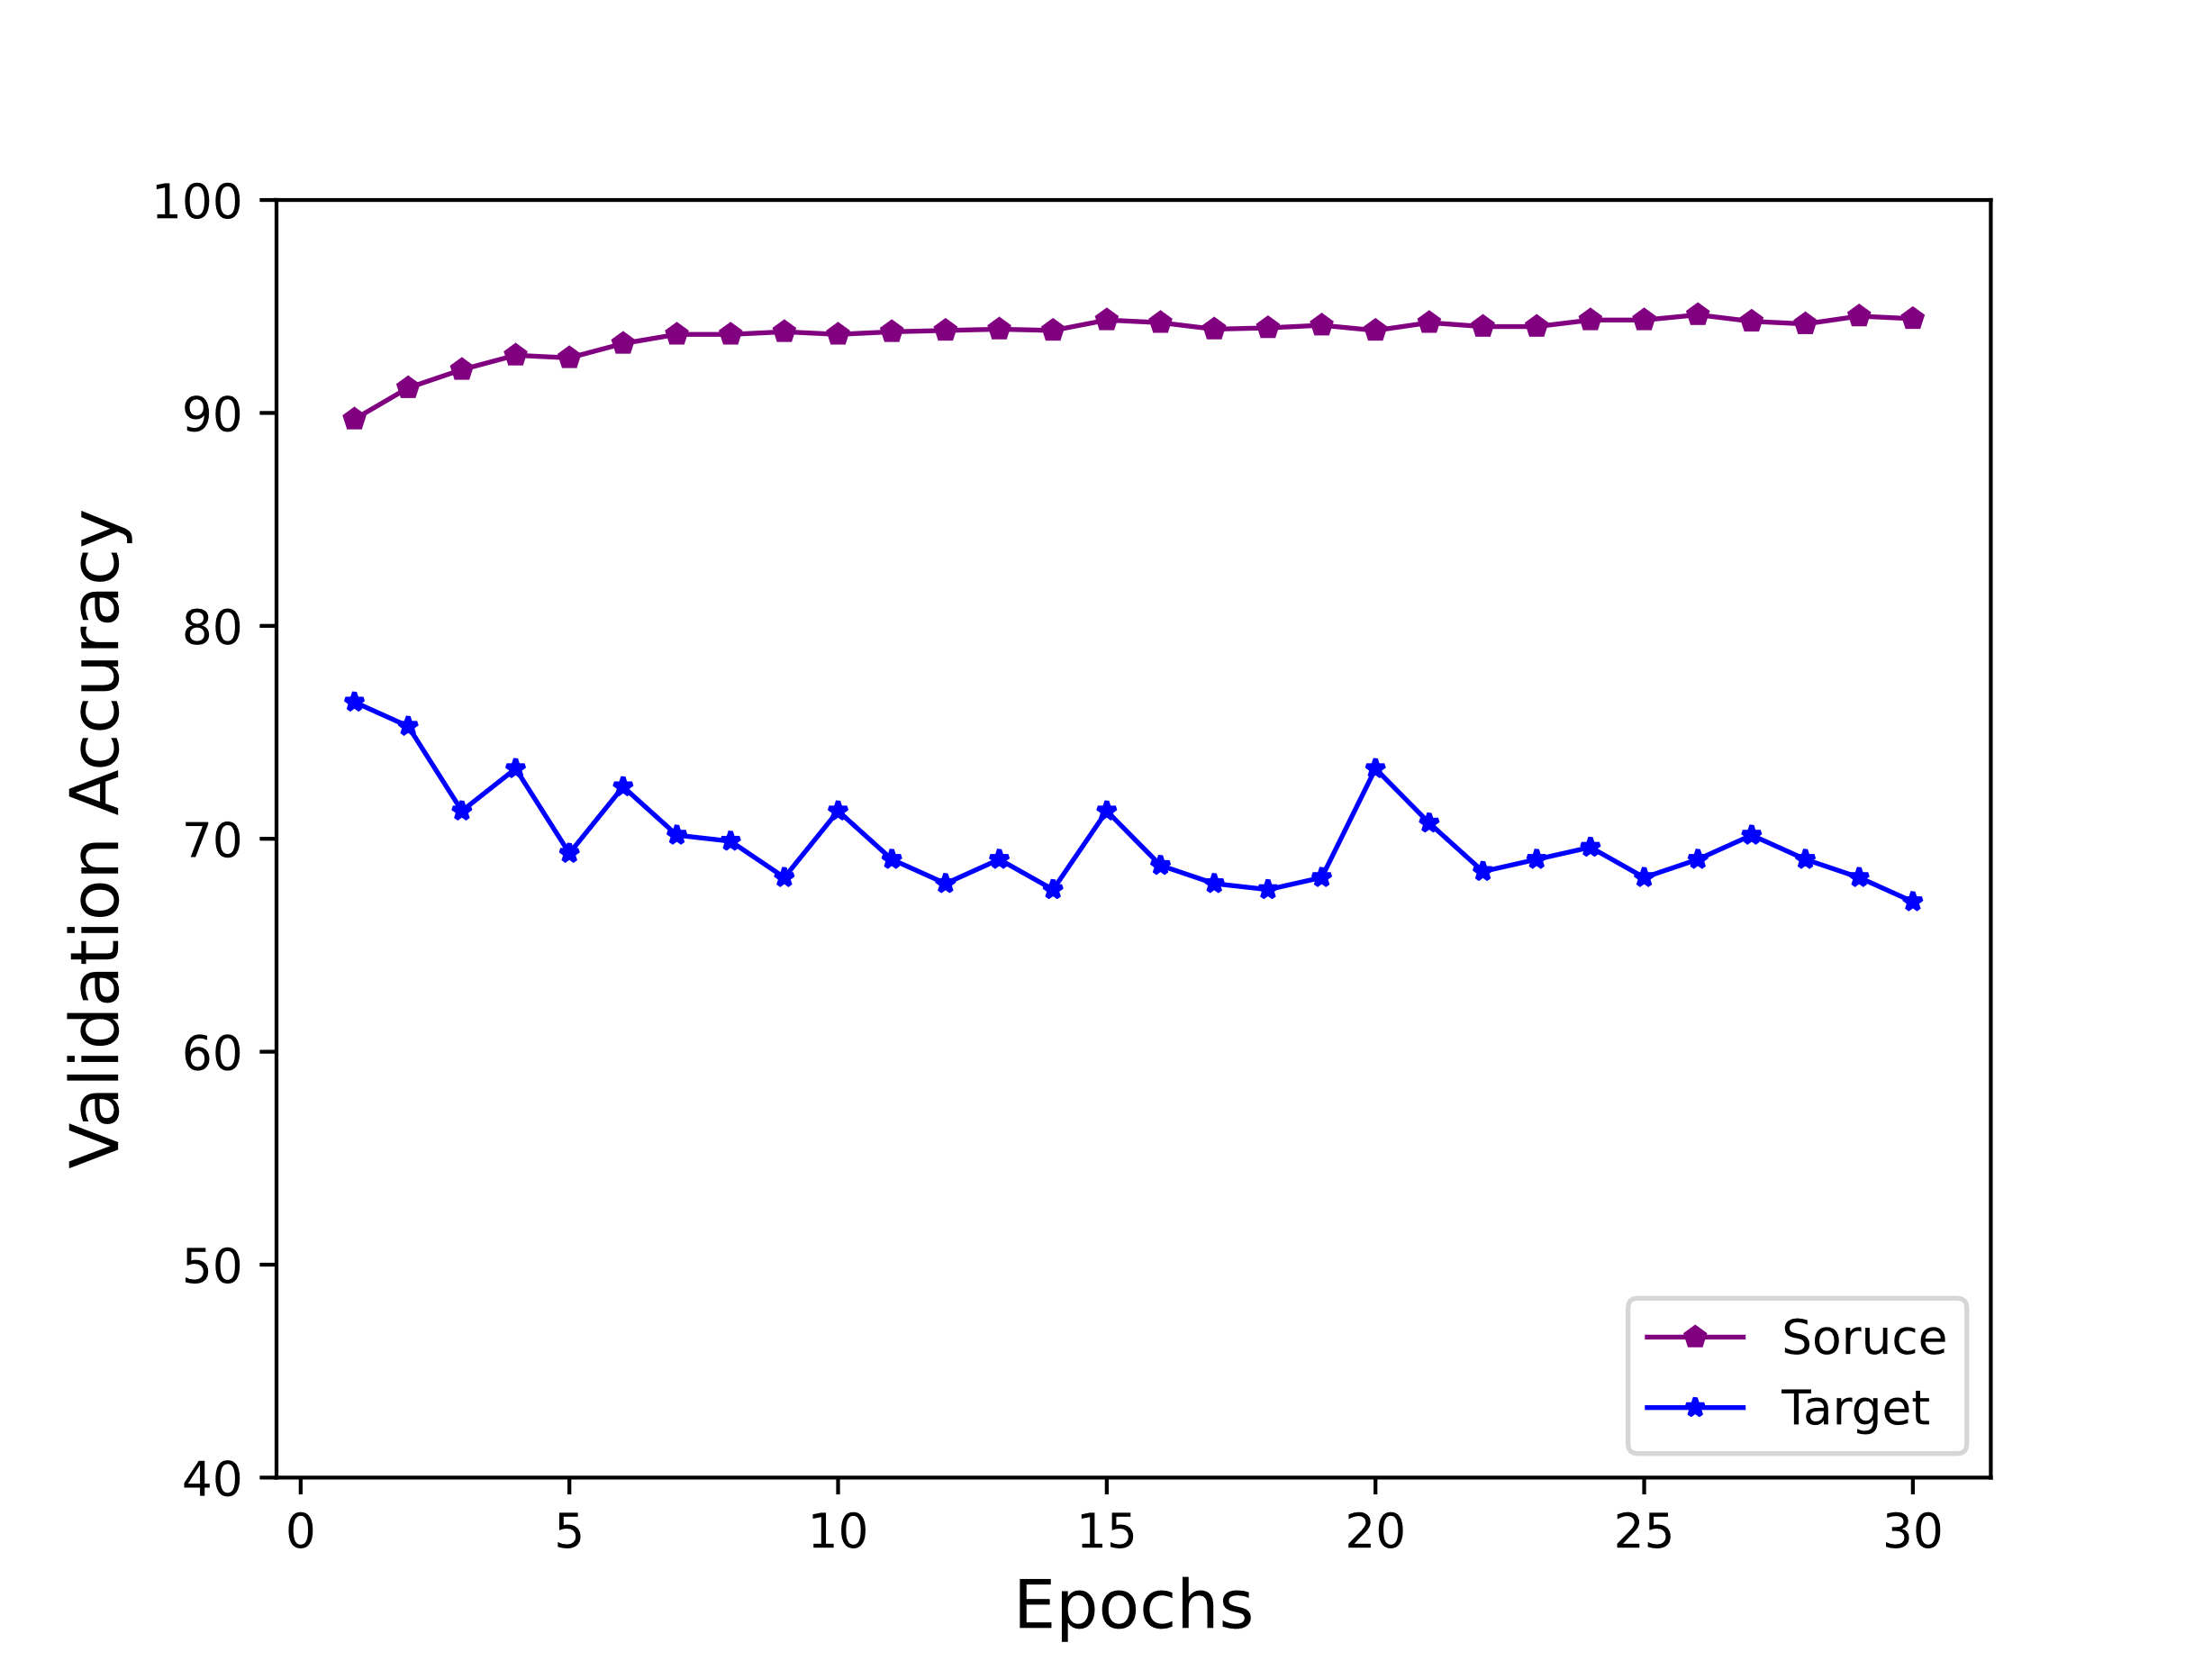
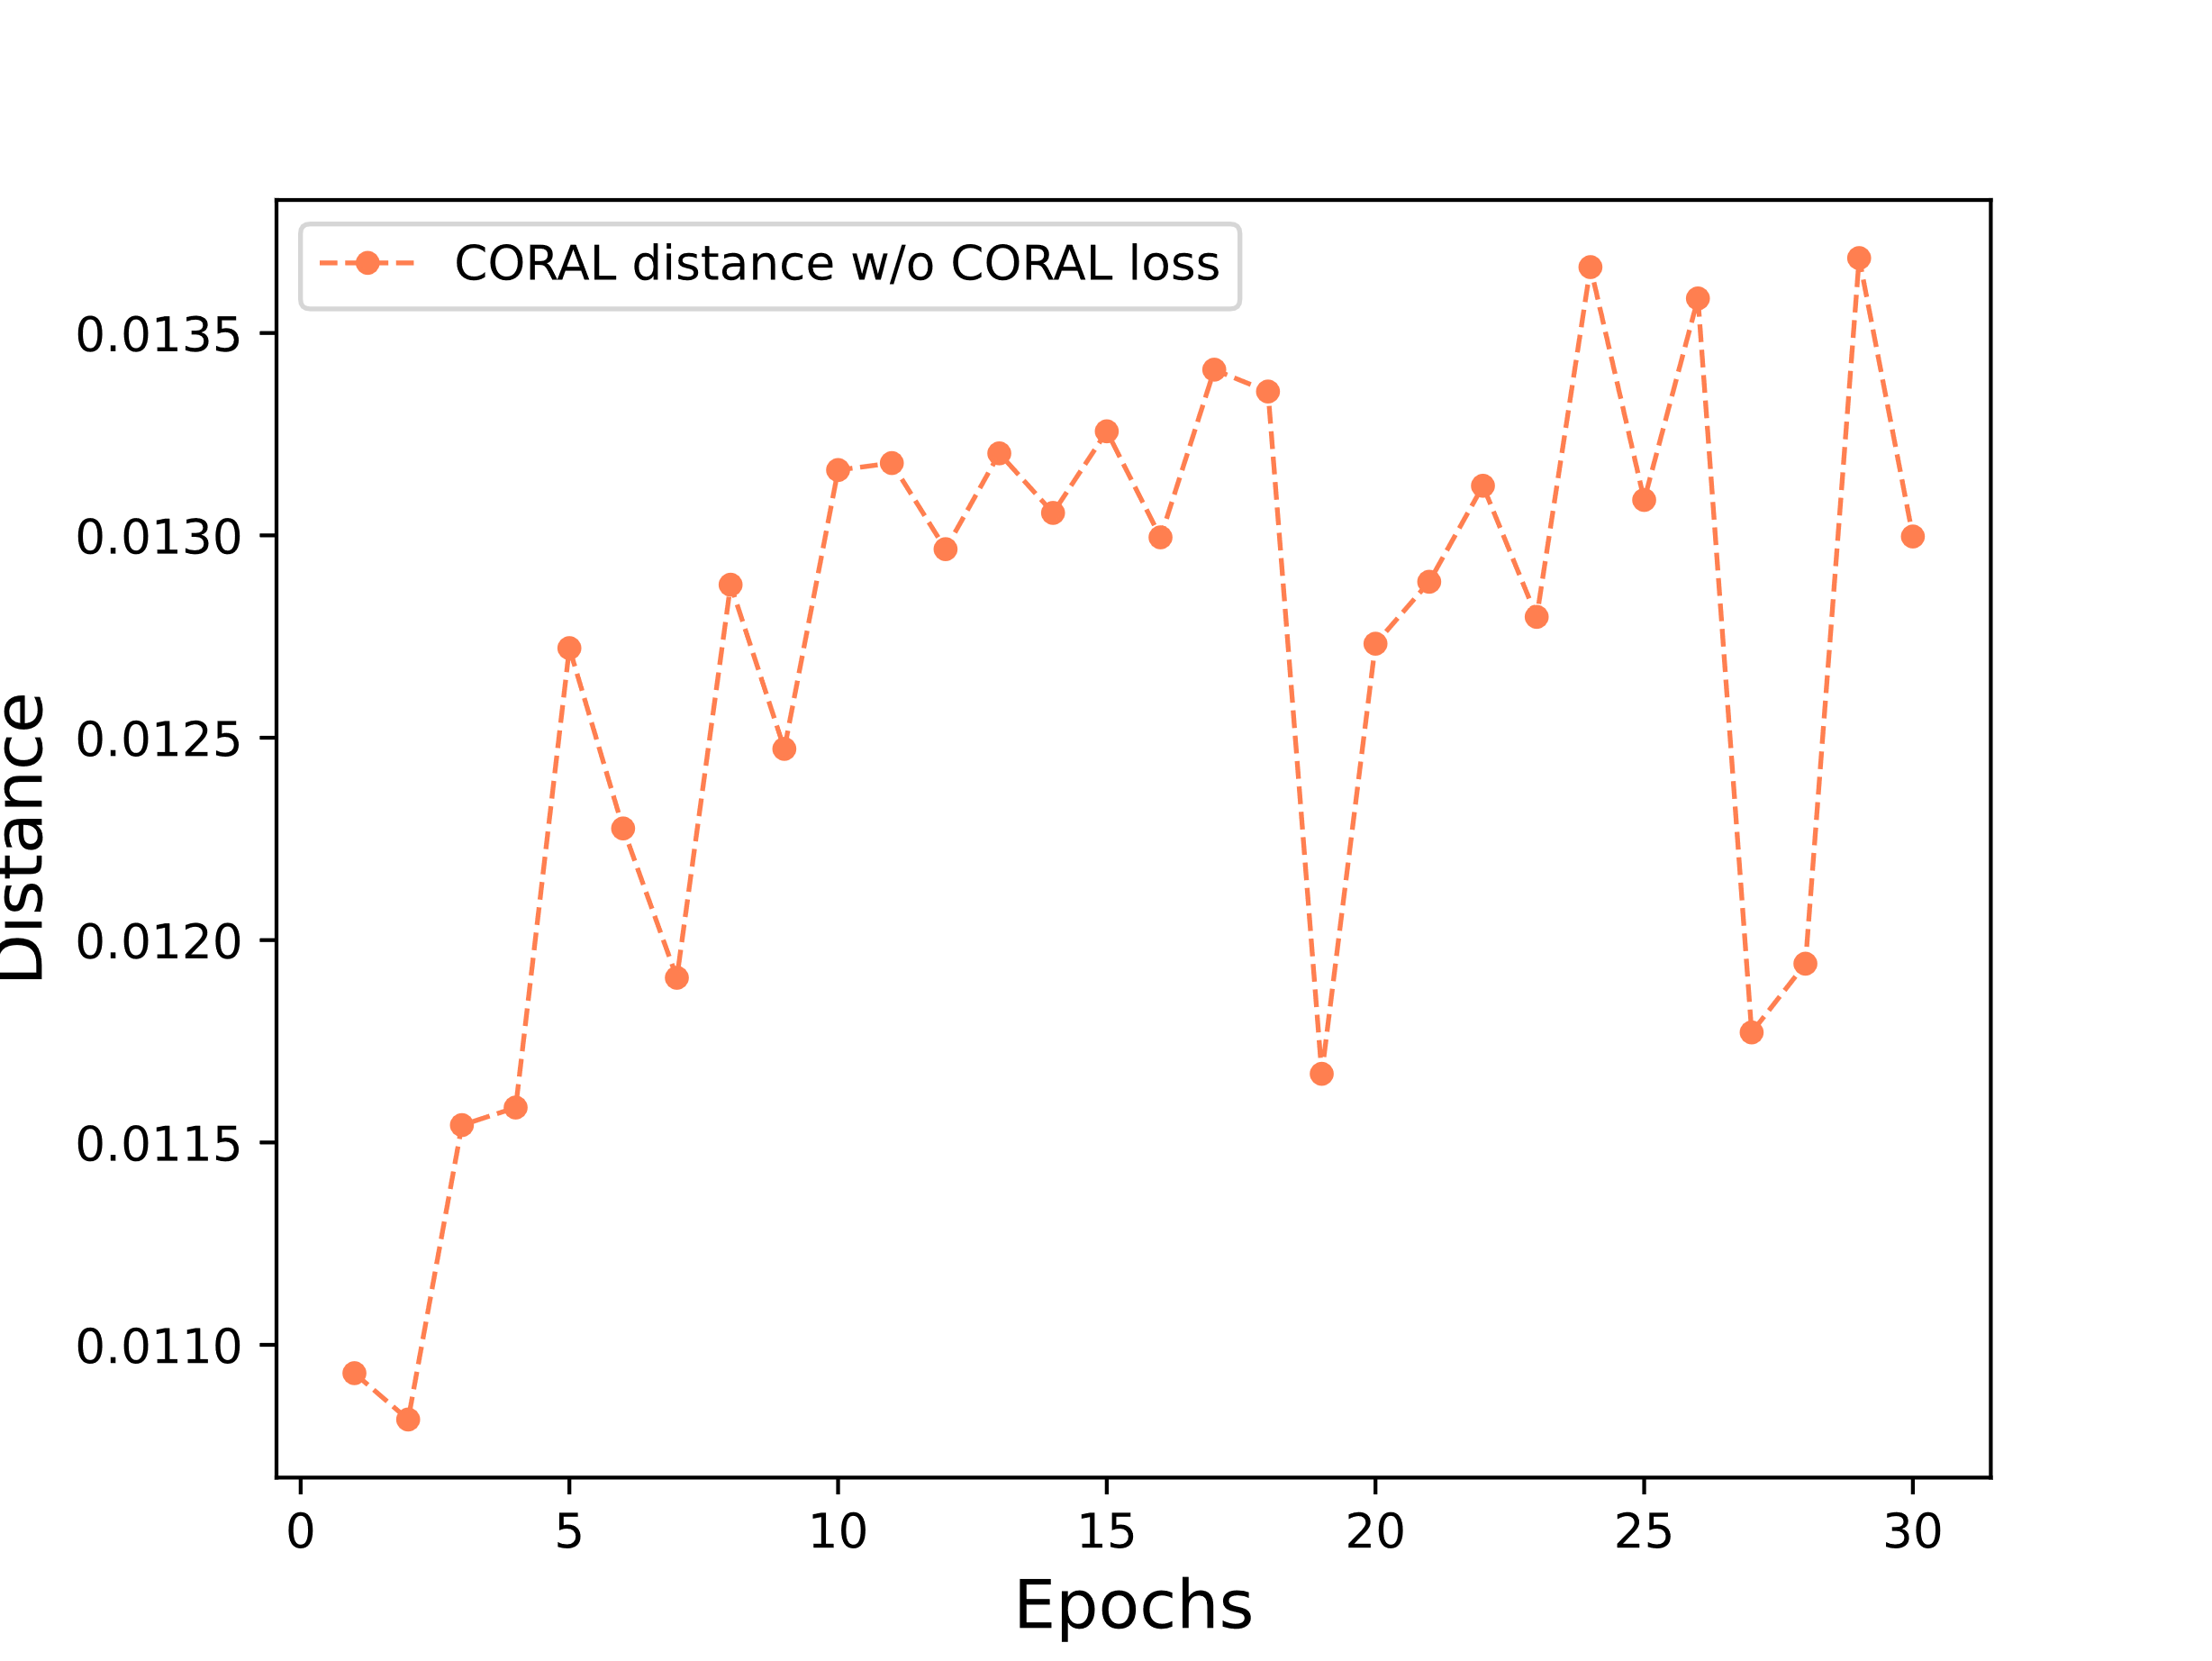
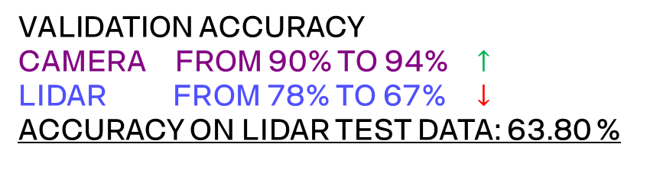
finetuned model on camera images training history
VALIDATION ACCURACY
CAMERA FROM 90% TO 94% $↑$
LIDAR FROM 78% TO 67% $↓$
ACCURACY ON LIDAR TEST DATA: 63.80 %
CORAL DISTANCE IS INCREASING
Notes:
JOEL

Slide 22
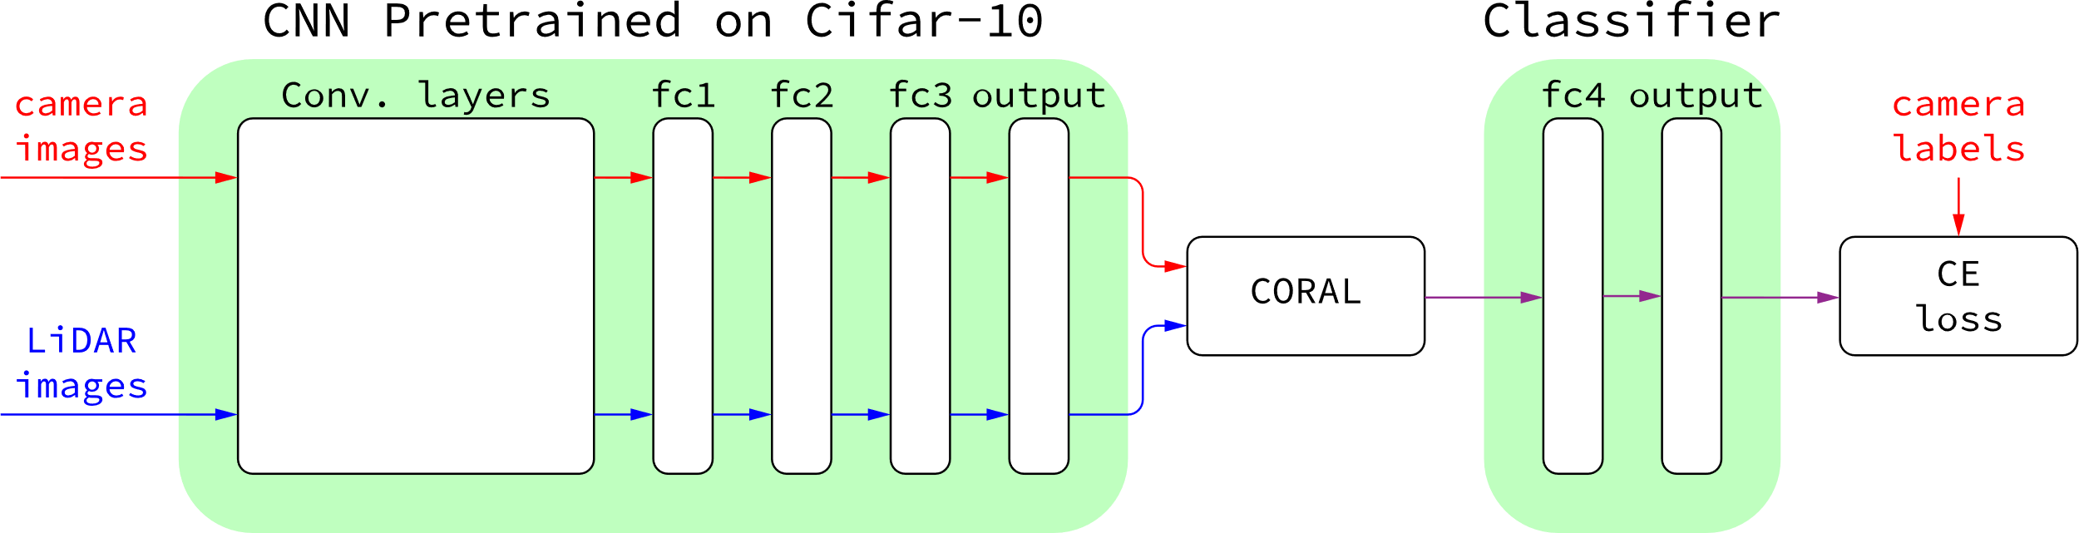
CORAL model
Camera deep features aligned to Lidar deep features
Linear classifier trains on aligned camera features
ACCURACY ON LIDAR TEST DATA: 74.67 %
Notes:
JOEL

Slide 23
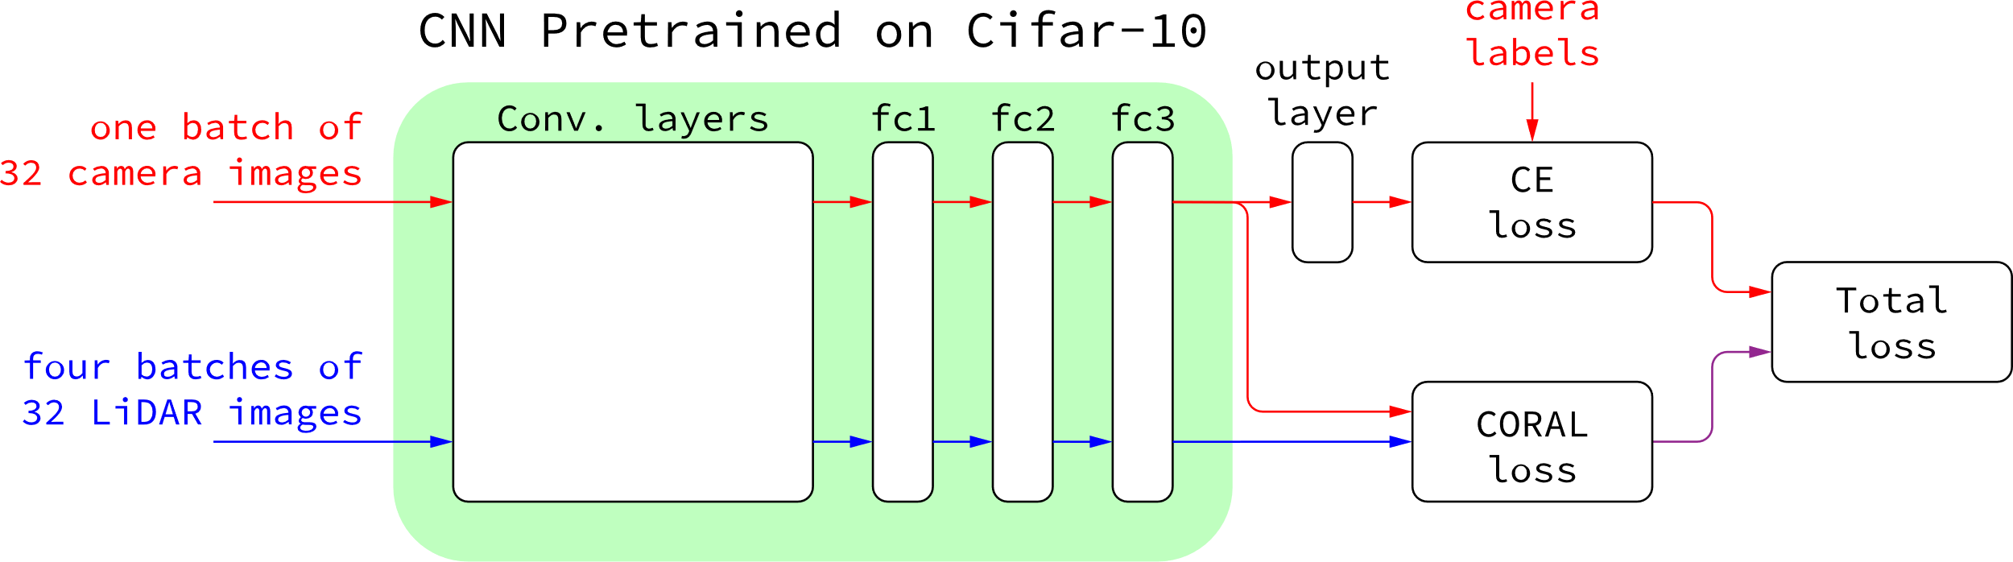
DEEP CORAL model
Camera and LiDAR deep features compared in CORAL loss
Model parameters updated w.r.t. CE loss and CORAL loss
Notes:
JOEL

Slide 24
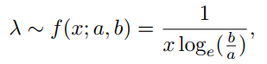
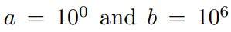
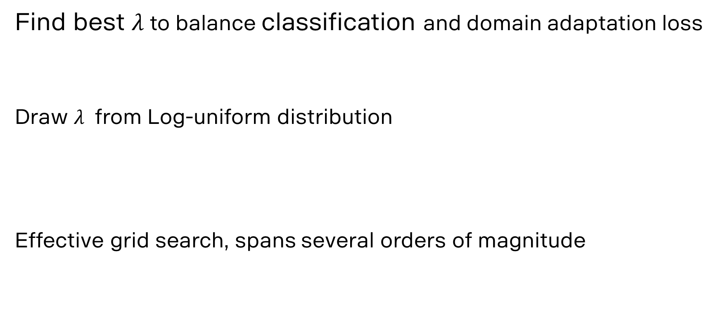
DEEP CORAL model HYPERPARAMETER TUNING
Find best $λ$ to balance classification and domain adaptation loss
Draw $λ$ from Log-uniform distribution
Effective grid search, spans several orders of magnitude
Notes:
JOEL

Slide 25
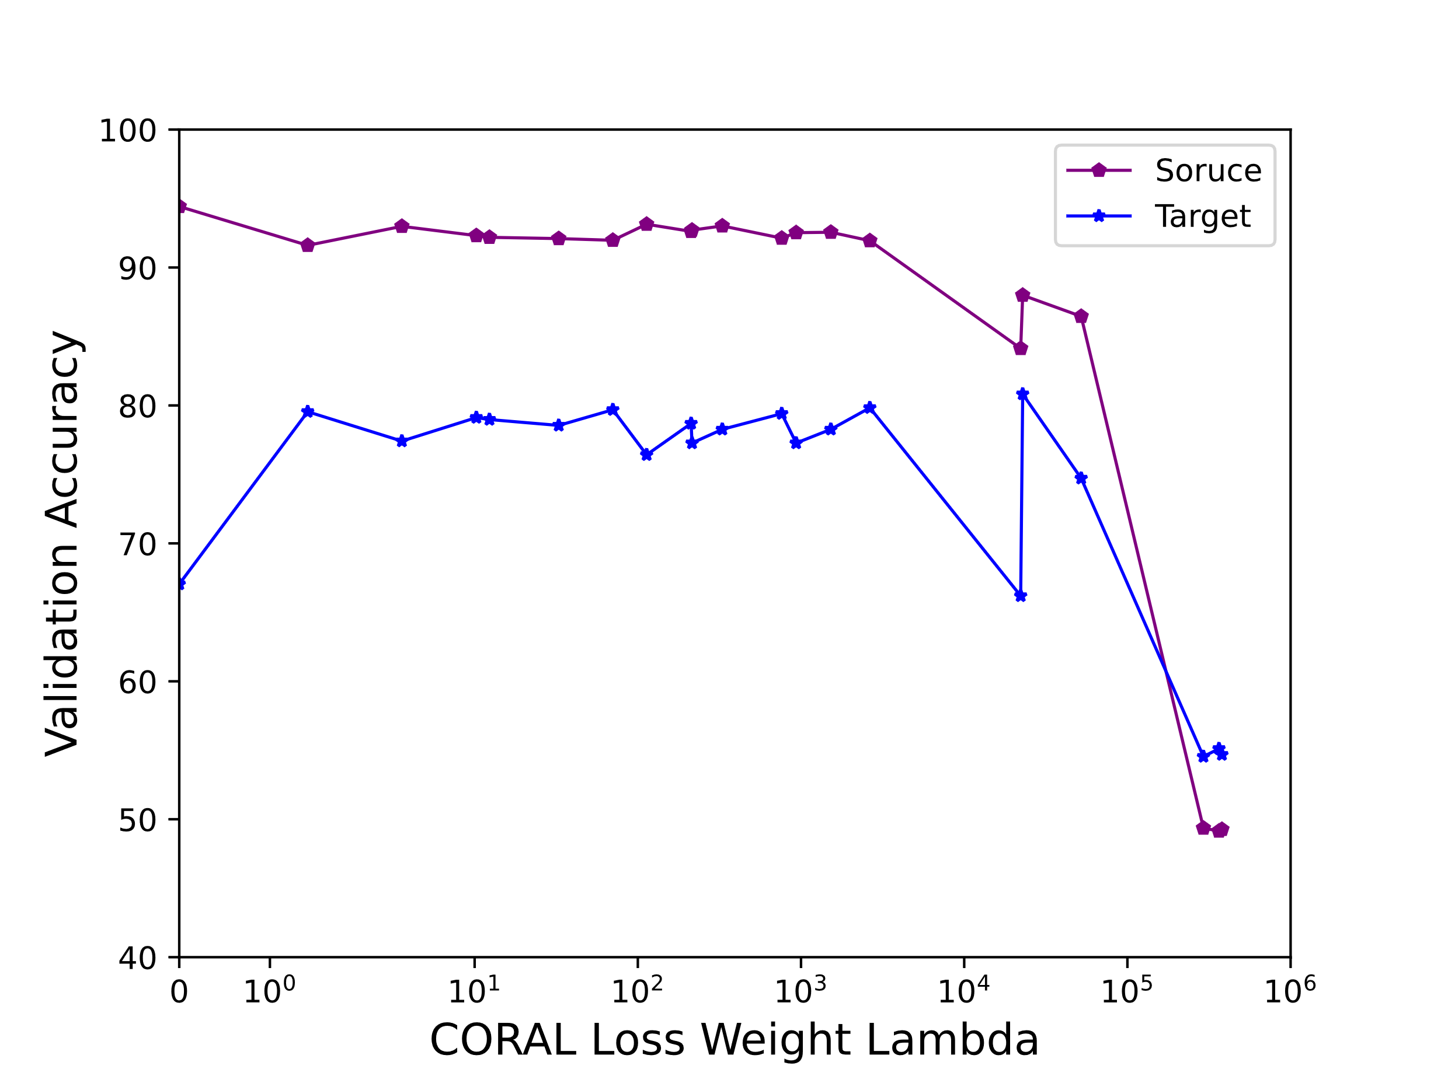
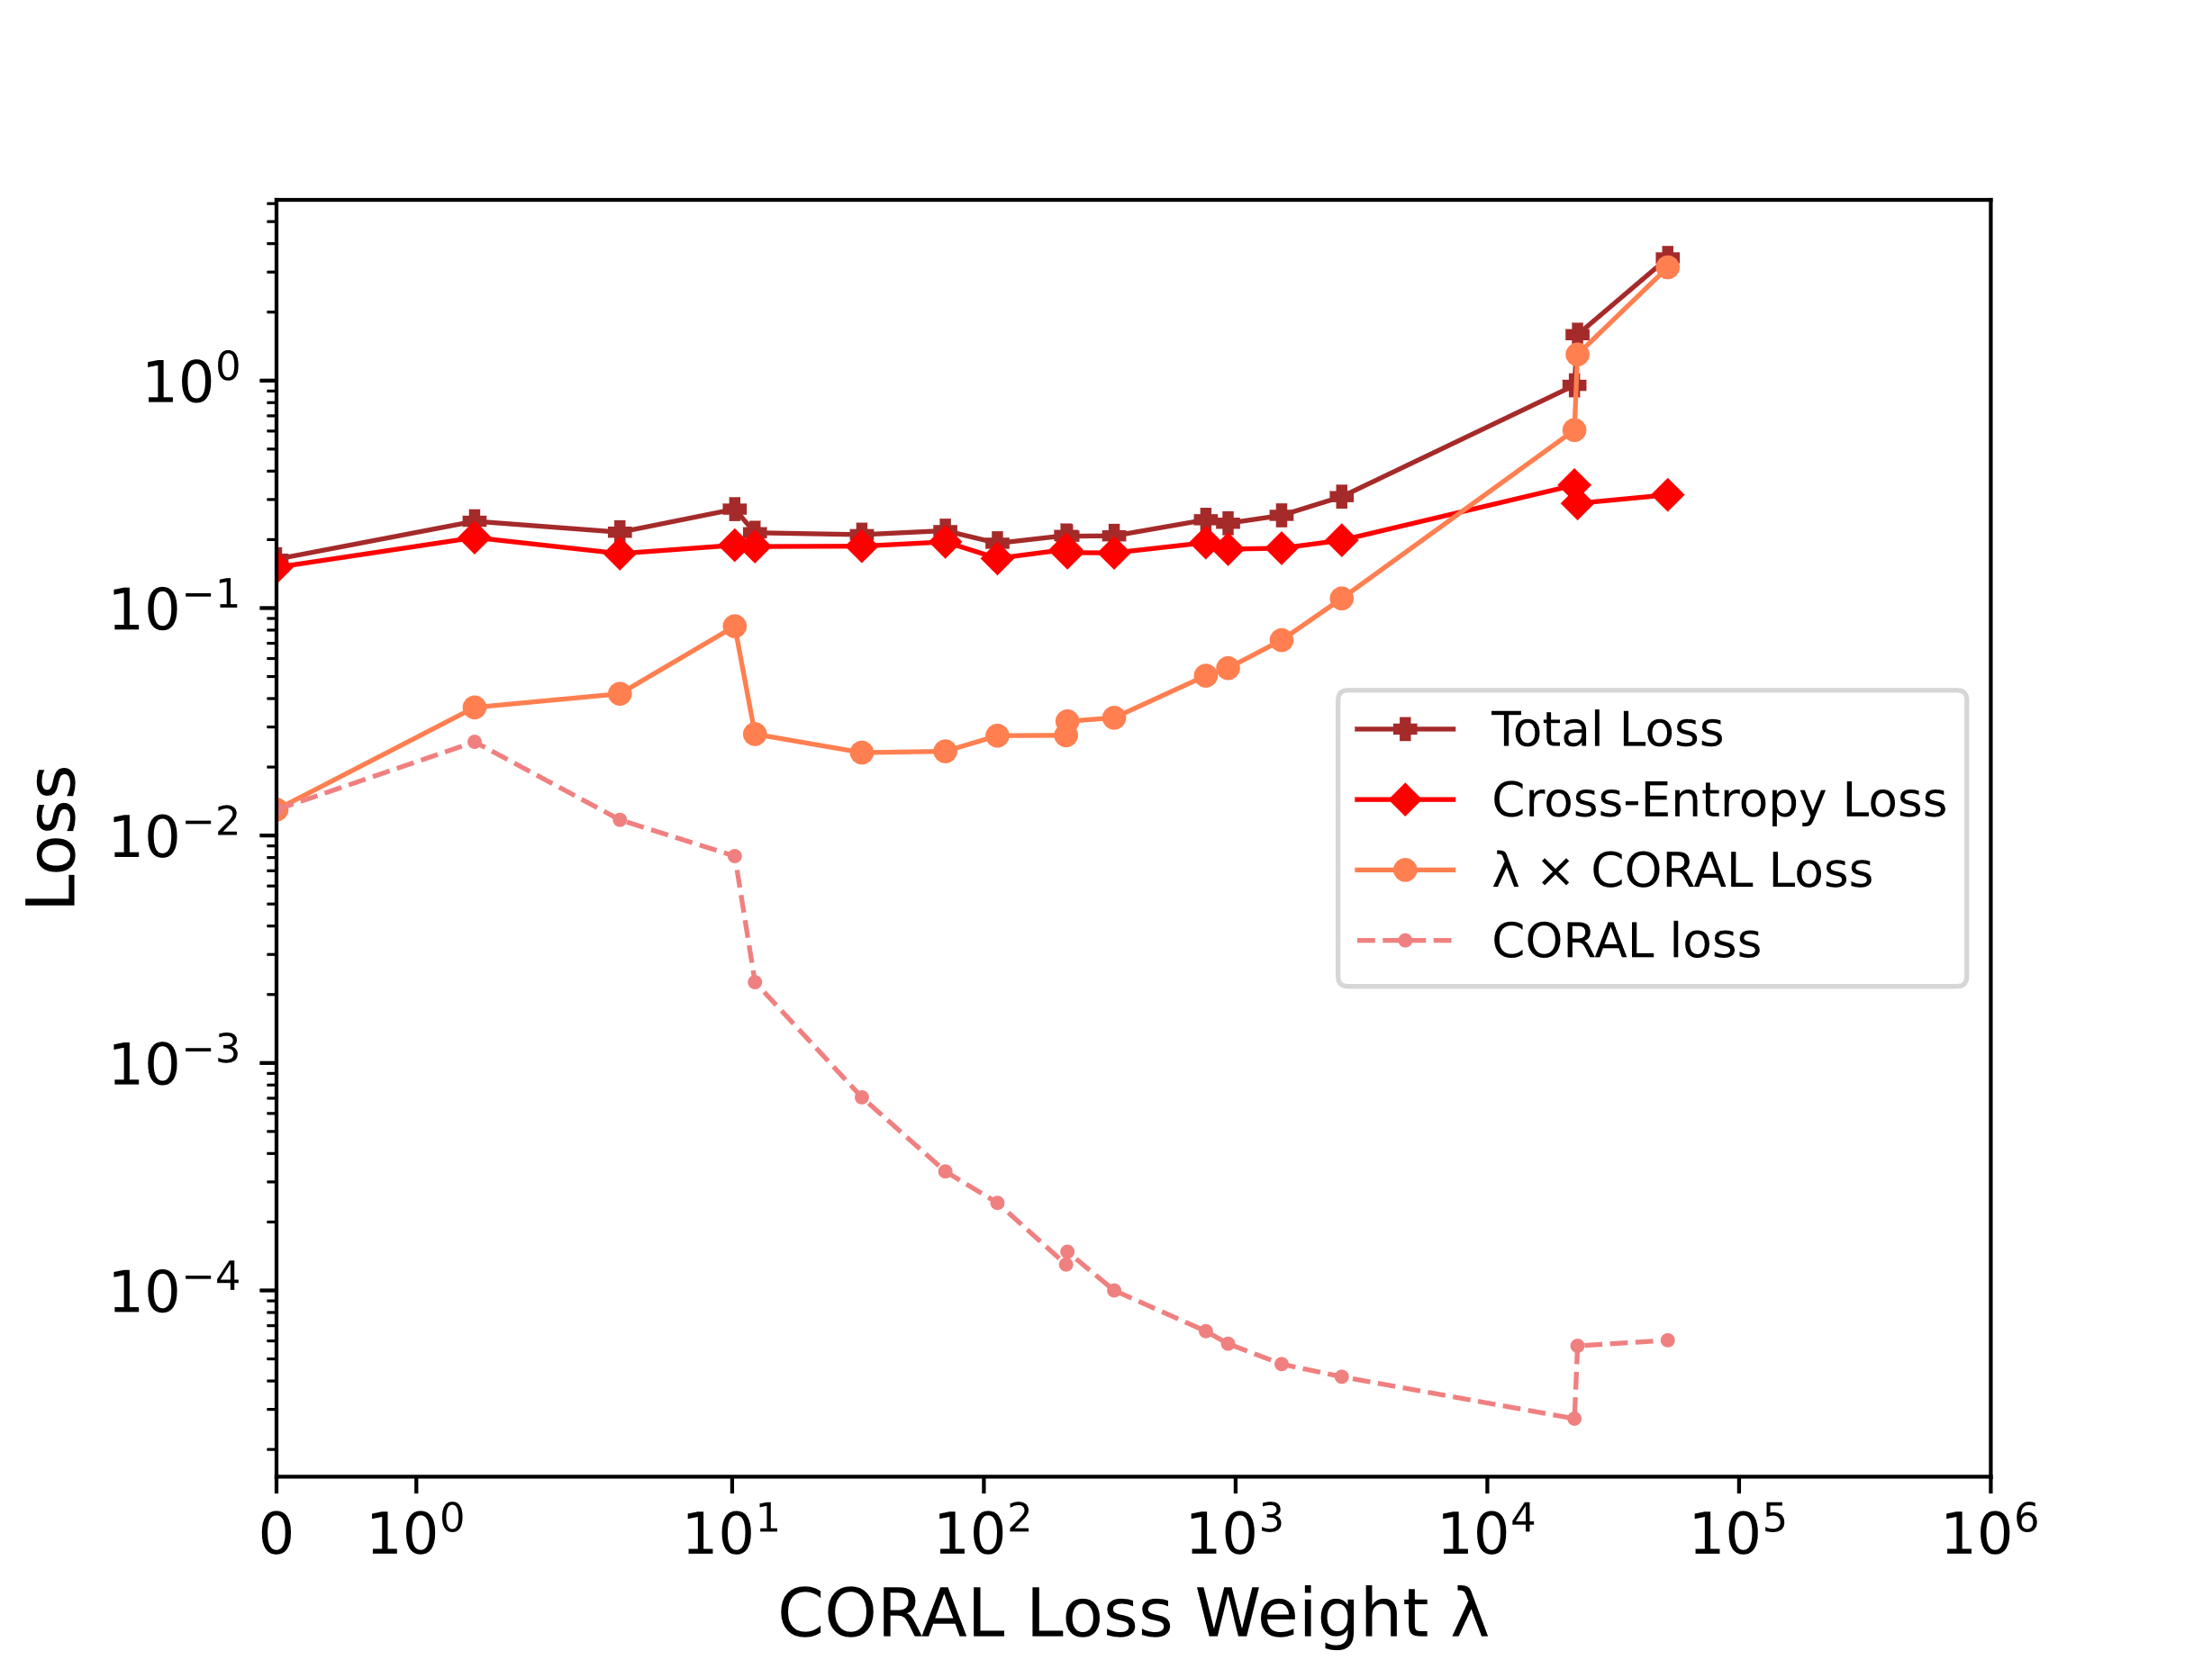

DEEP CORAL model HYPERPARAMETER TUNING
From $λ=0$ to $λ={10}^{6}$
Best result at$λ=70.299$
Highest LiDAR accuracy = 79.69% and lowest weighted coral loss
Notes:
JOEL

Slide 26




DEEP CORAL model Training with $λ=70.299$
LiDAR accuracy maintained!
CORAL loss decreases!
Notes:
JOEL

Slide 27

Deep CORAL model
Deep model without CORAL loss
Notes:
JOEL

Slide 28




Separability of data TSNE: T-distributed Stochastic Neighborhood Embedding
High-dimensional LiDAR deep features embedded onto 2D
Extracted at second-to-last fully connected layer
(Red: Pedestrians, Blue: Cars)
Supervised learning on camera data
Shallow CORAL model
Deep CORAL model
with $λ=70.299$
Increased separability
Notes:
JOEL

Slide 29



THE confusion matrix class-wise prediction accuracy of lidar images
Supervised learning on camera data
Accuracy: 63.8%
Shallow CORAL model
Accuracy: 74.67%
Deep CORAL model
Accuracy: 80.73%
True labels
Predicted labels
Less bias towards prediction cars
Higher accuracy
Notes:
MIKAEL

Slide 30
Conclusions
Shallow and deep CORAL methods can adapt model to increase accuracy in the target domain.
Superiority of deep CORAL suggests:
Embedding DA method into deep framework is better
Model parameters updated to learn more robust representation of the DA task
Notes:
MIKAEL

Slide 31
THANKS to…
Supervisor Arash Owrang
Thesis co-worker Mikael Westlund
The whole perception team at Scania!
Subject reader Dominik Baumann

Slide 32
And thank you for listening

